Slide 1
Practical – 1
Machine Learning

Slide 2
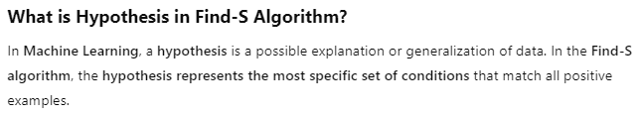
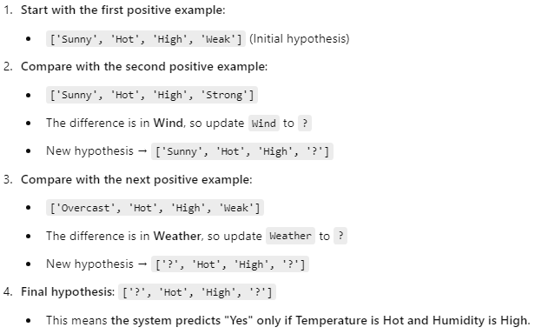
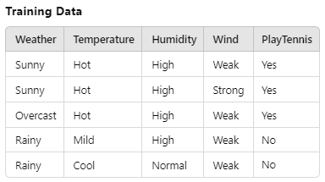
AIM: Implement and demonstrate the FindS algorithm for finding the most specific hypothesis based on a given set of training data samples. Read the training data from a CSV file.

Slide 3
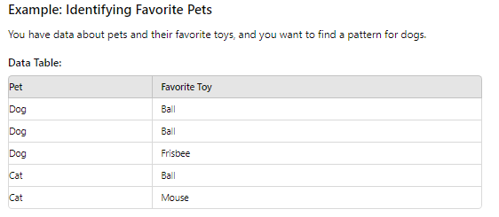
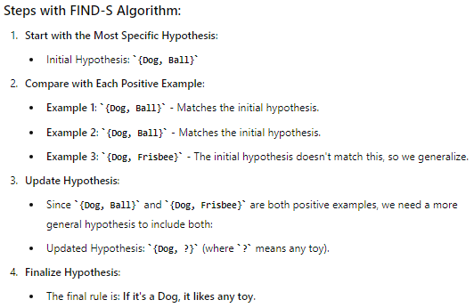
FIND-S Algorithm

Slide 4
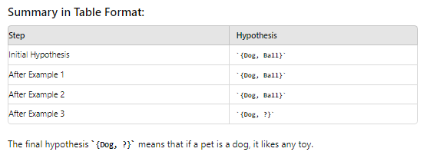
FIND-S Algorithm

Slide 5
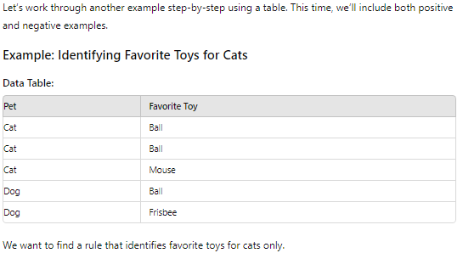
FIND-S Algorithm

Slide 6
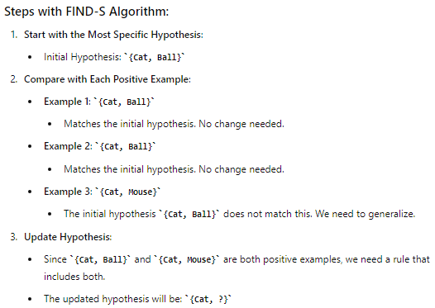
FIND-S Algorithm

Slide 7
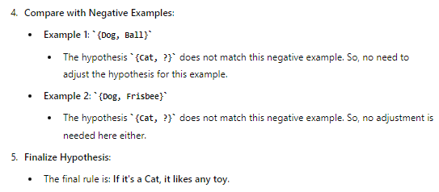
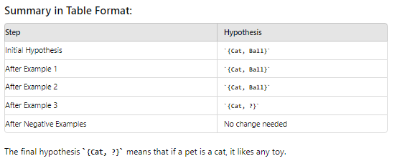
FIND-S Algorithm

Slide 8
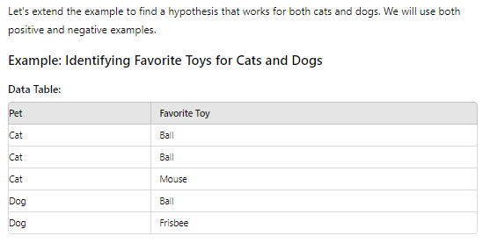
FIND-S Algorithm

Slide 9
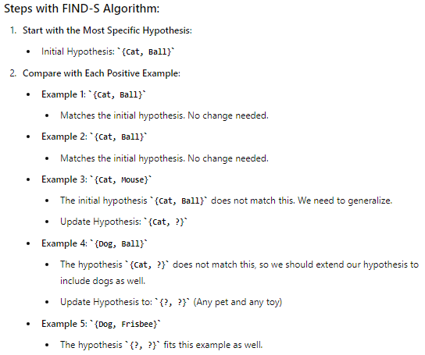
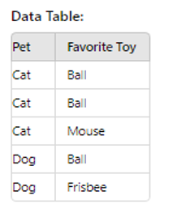
FIND-S Algorithm

Slide 10
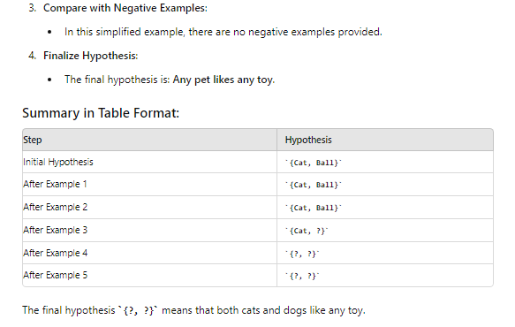
FIND-S Algorithm

Slide 11
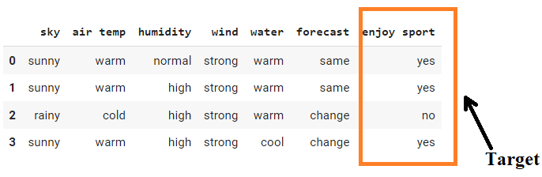
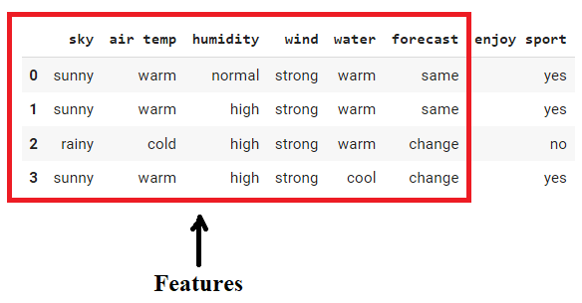
This is how the dataset of Practical 1 is:-

Slide 12

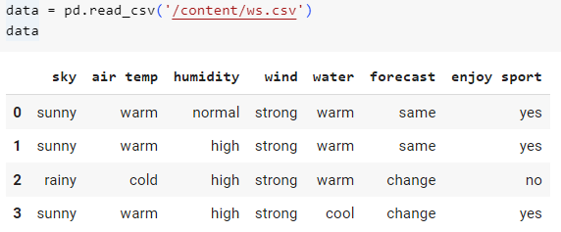
import pandas as pd: Imports the pandas library and assigns it the alias pd, which is used for data manipulation and analysis.
import numpy as np: Imports the numpy library and assigns it the alias np, which is used for numerical operations with arrays and matrices.
pd.read_csv(): This function reads a CSV file and returns it as a DataFrame.
'/content/ws.csv': The path to the CSV file you want to read.
data: A variable that stores the DataFrame created from the CSV file.

Slide 13
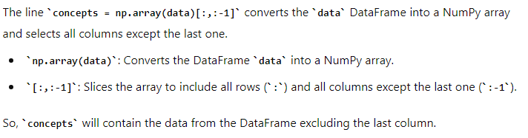
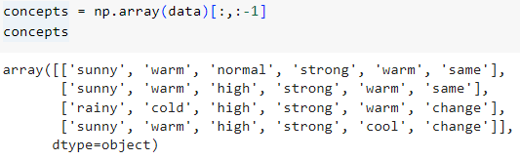

Slide 14
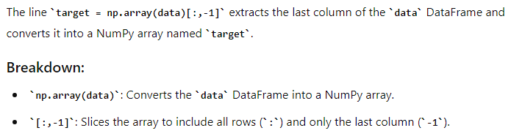


Slide 15
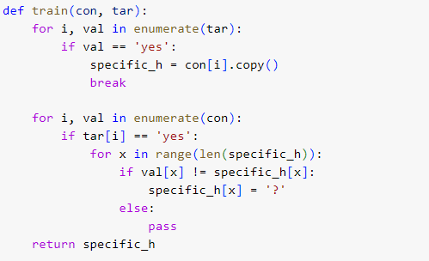
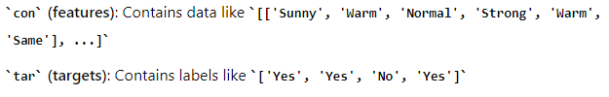

Slide 16

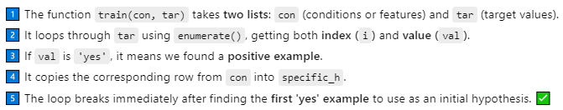
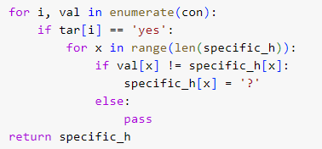
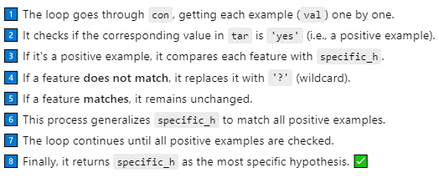

Slide 17
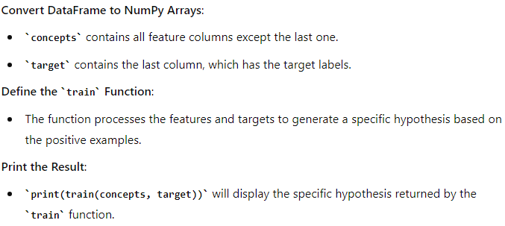
For each feature vector where the target label is 'yes’:
Compare it to the current specific_h.
If a feature value in the current vector does not match specific_h, replace that feature value in specific_h with a ?.
Returns the refined hypothesis which represents the rule that matches all positive examples as closely as possible.
Finds the first feature vector where the target label is 'yes' and sets specific_h to this feature vector.

Slide 18
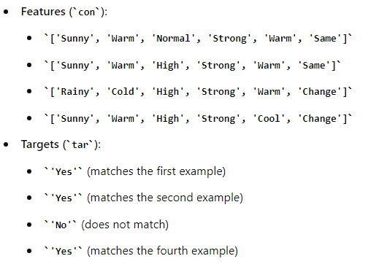
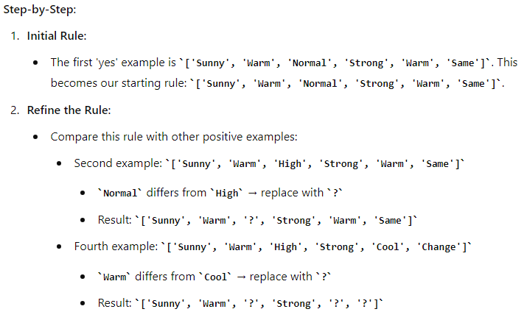

Slide 19
